Slide 1


Map Data with sf & leaflet

Slide 2
Motivation
sf
ggmap
Leaflet
Basemaps
Lines
Points
Shapes
Legends & Colors
leaflet.extras
Heatmaps

Slide 3
Motivation

Slide 4
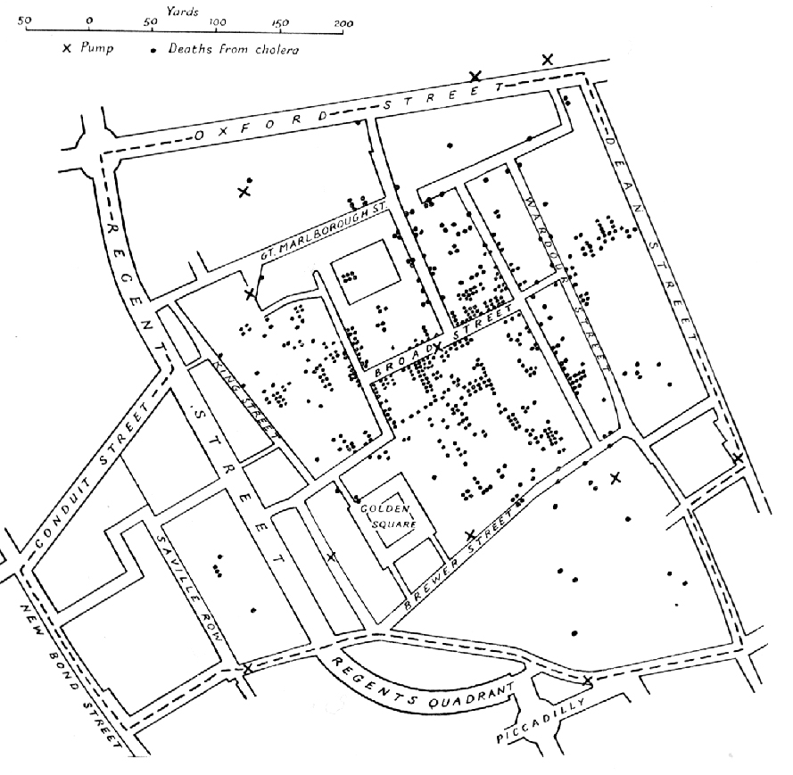
Map of the 1854 Cholera outbreak - John Snow

Slide 5
“‘I have the same problem’ is a famous last post in many forum-threads on the esri forum.”
–sebastian

Slide 6


Slide 7
“R and Leaflet are free and open-source, ArcMap is very much not.”
–Geoffrey Arnold

Slide 8
Packages
Install these packages:
rgdal: https://github.com/cran/rgdal/blob/master/inst/README
rgeos
sf
leaflet
leaflet.extras

Slide 9
Spatial Data
with sf

Slide 10
Loading spatial data
Sometimes your source data will be a data frame which you will need to join to spatial data, other times it will be included
It may also be a CSV with coordinates, in those instances no further cleaning needs to take place

Slide 11
demo
examples.Rmd
Go to loading code chunk

Slide 12
Importing data
polls <- st_read("Allegheny_County_Polling_Place_Locations_November_2016.geojson")
cds.load <- st_read("./cb_2015_us_cd114_500k/cb_2015_us_cd114_500k.shp")
plot(cds.load)

Slide 13
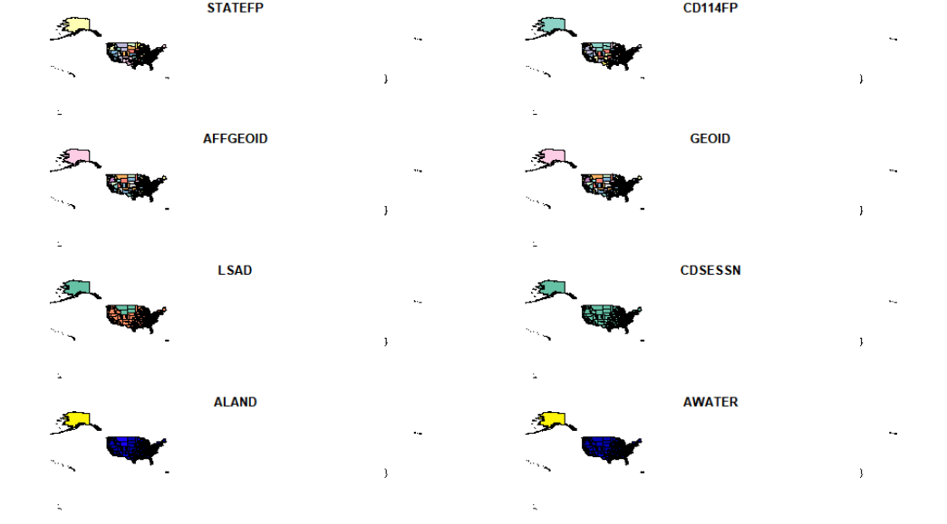
Basic Plot
plot(cds.load)

Slide 14
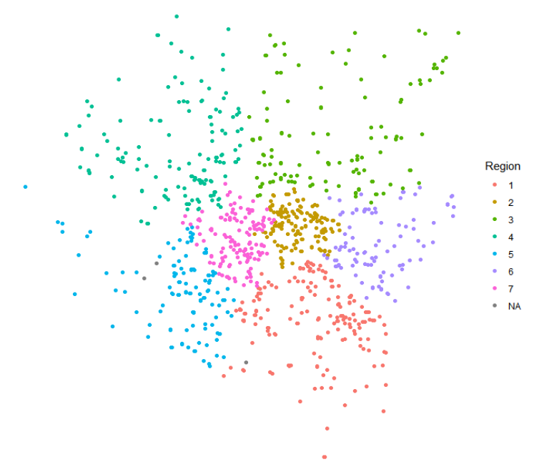
Basic ggplot
ggplot(data=polls, aes(color = Region)) +
geom_sf() +
theme_void()

Slide 15
Adding a basemap
Request an API Key here: https://client.stadiamaps.com/signup/
Check your email and enter the API key into the code below and run in the terminal
register_stadiamaps(“Your-API-Key-here", write = TRUE)

Slide 16
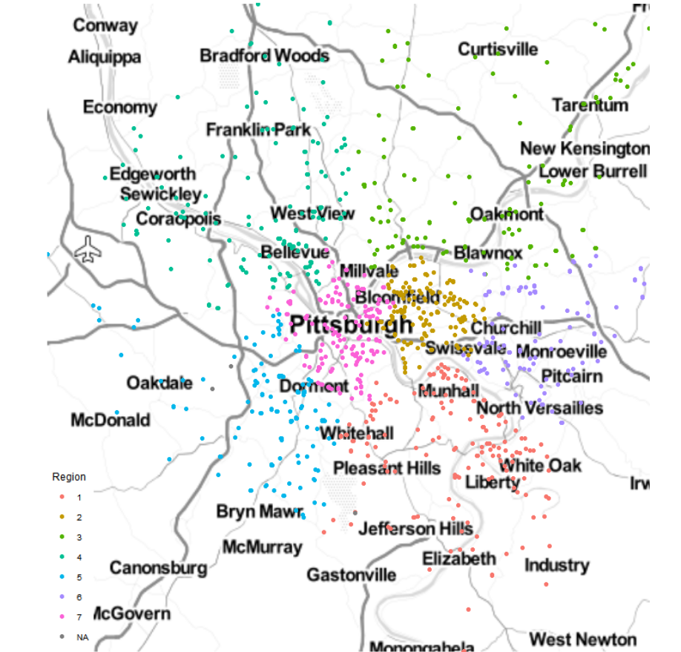
Get a Stamen API Key
# Get the boundaries of your file to get the basemap
bbox <-st_bbox(polls) %>% setNames(c("left", "bottom", "right", "top"))
# Get the API Key from the .Renviron
ggmap::register_stadiamaps(Sys.getenv("GGMAP_STADIAMAPS_API_KEY"))
# Load API Basemap
map <- get_stadiamap(bbox, maptype = "stamen_toner_lite")
# Add map info to basemap
map %>%
ggmap() +
coord_sf(crs = st_crs(3857)) +
geom_sf(data=polls, aes(color = Region), inherit.aes = FALSE) +
theme_map()

Slide 18
What is leaflet?
R version of the Javavscript API of Leaflet
One of the ways to get interactive maps
Others include: tmap, mapview and plotly
Documentation: https://rstudio.github.io/leaflet/

Slide 19
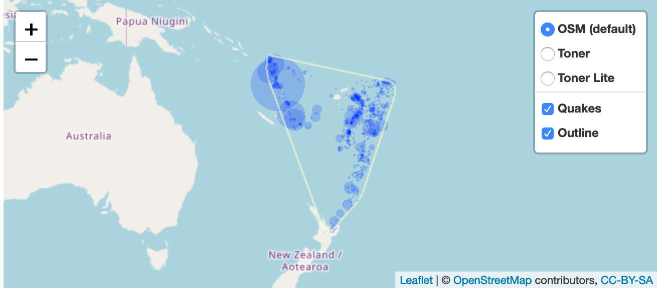
Group Controls
In leaflet you can add groups and give them a name.
Group names are what show up in the layer control
addProviderTiles(providers$Stamen.Toner, group = “Toner”) %>%
addLayersControl(
baseGroups = c("OSM (default)", "Toner", "Toner Lite"),
overlayGroups = c("Quakes", "Outline"),
options = layersControlOptions(collapsed = FALSE)
)

Slide 20


exercise
Create a map with layer controls
Get basemap provider names from here: https://leaflet-extras.github.io/leaflet-providers/preview/
Create 3 named basemap groups
Add a layer control that has the named base groups

Slide 21
Shapes

Slide 22
Typical arguments
lng (if a column)
lat (if a column)
layerId
group (for layerControls)
stroke (boolean, shape outline)
color (outline color, hex values)
weight (outline width)
opacity (alpha of the line)
fill (boolean)
fillColor (hex color)
fillOpacity (alpha of fill)
And more!

Slide 23
exercise
Using the example cds to create a polygon layer
Make sure to include a basemap

Slide 24
Solution
leaflet(data = cds) %>%
addProviderTiles("Stamen.Toner") %>%
addPolygons()

Slide 25
Palettes
palette (color brewer palette)
domain (values to be colored)
na.color
alpha
reverse (values of palette)
bins
pretty
right (for cutting)
n (number of quanitites)
probs
levels
ordered

Slide 26
Legends
position (“bottomright” etc…)
pal (palette from colorBrewer)
values (domain from data)
na.labels
bins (buckets)
colors
labFormat (separate function labelFormat)
title
className (for custom CSS to apply)
layerId (for input usage)
group (for layerControls)
digits
big.mark
transform (function to be applied to labels)

Slide 27
exercise
Choropleth Polygon map with
Create a color palette for Life Expectancy at Birth (years) column in the merged Congressional District data.
addPolygons to a leaflet map and apply palette to column
Stretch goal: Add a legend
Hint: https://rstudio.github.io/leaflet/choropleths.html

Slide 28
demo
08-Maps-Exercises.Rmd
Go to polygon code chunk

Slide 29
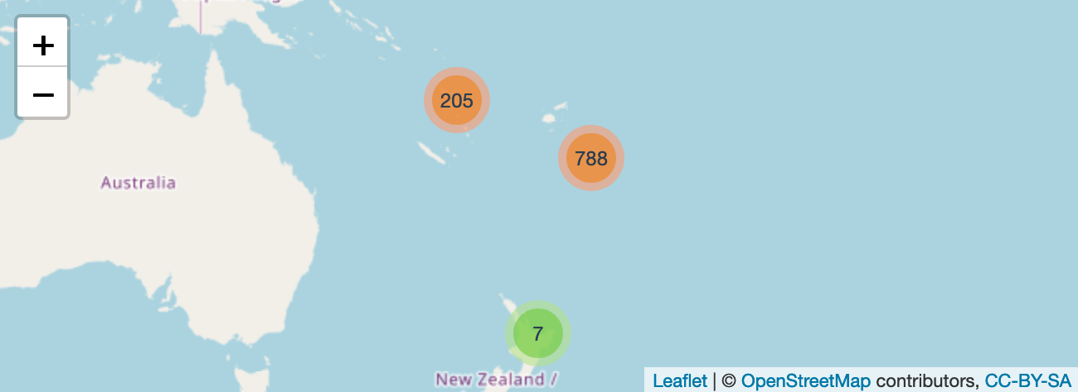
Clusters
leaflet(quakes) %>%
addTiles() %>%
addMarkers(
clusterOptions = markerClusterOptions()
)

Slide 30
Why clusters?
Sometimes there’s just a ton of data to show and trying to visualize them will bring any browser window it a crawl.
Example: https://pittsburghpa.shinyapps.io/TreesNAt/

Slide 31
exercise
Go to 08-Maps-Exercises.Rmd clusters code chunk
Use 311 data to create a cluster map
Create a factor palette
Create a legend
Make sure to include a basemap
Hint: https://rstudio.github.io/leaflet/markers.html

Slide 32
leaflet
.extras

Slide 33
Leaflet.extras
Adds some pretty nice functions to complement leaflet
Tile caching: http://rpubs.com/bhaskarvk/TileLayer-Caching
weather icons: http://rpubs.com/bhaskarvk/leaflet-weather
Pulse icons: http://rpubs.com/bhaskarvk/leaflet-pulseIcon
and heat maps!

Slide 34
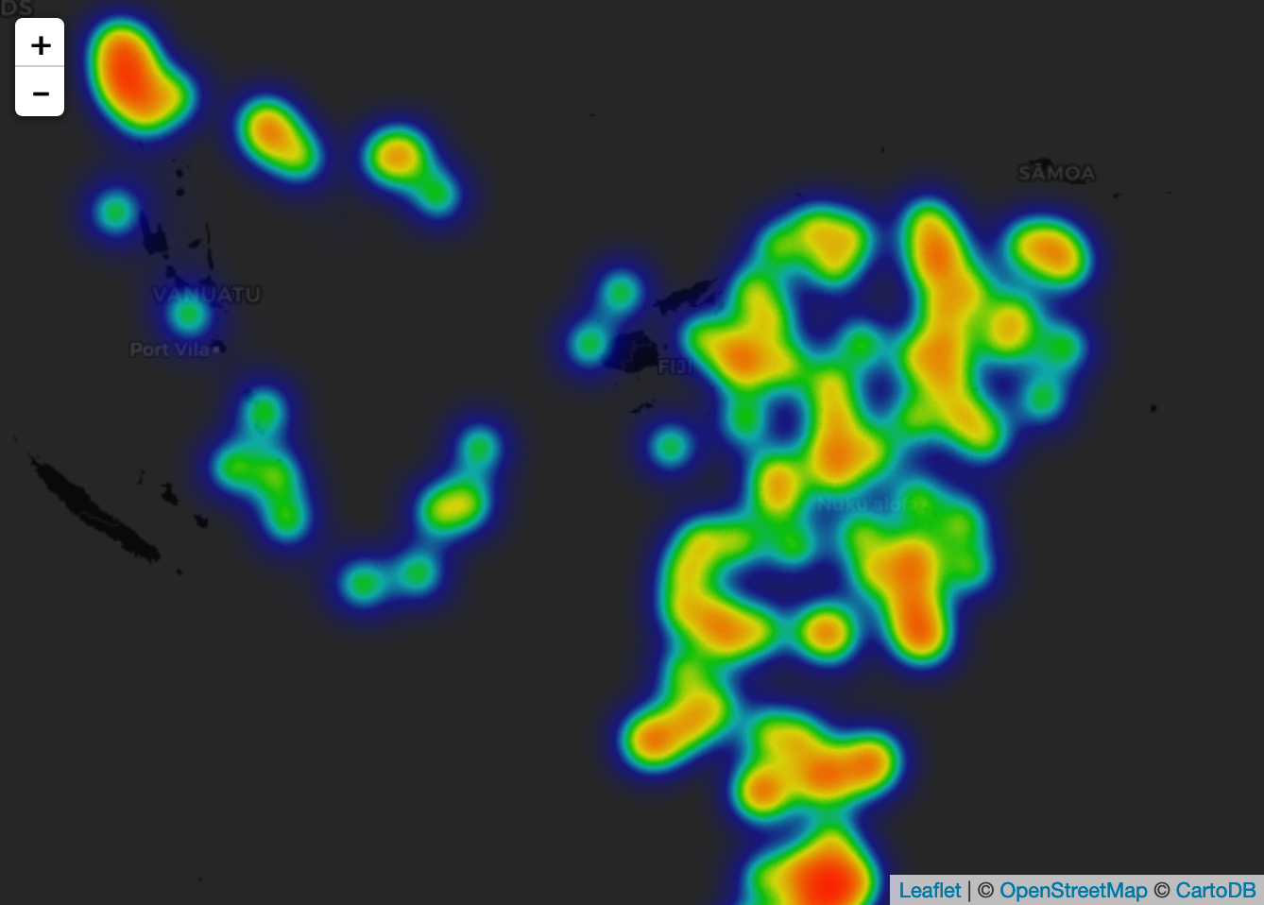
leaflet(quakes) %>%
addProviderTiles(providers$CartoDB.DarkMatter) %>%
setView( 178, -20, 5 ) %>%
addHeatmap(lng = ~long, lat = ~lat, intensity = ~mag,
blur = 20, max = 0.05, radius = 15)

Slide 35
exercise
Using the pothole data create a heat map
This won’t be very different from your cluster map from before.
Play around with the arguments for heat maps and find a radius that looks good.
Compare your outcome with your neighbor

Slide 36
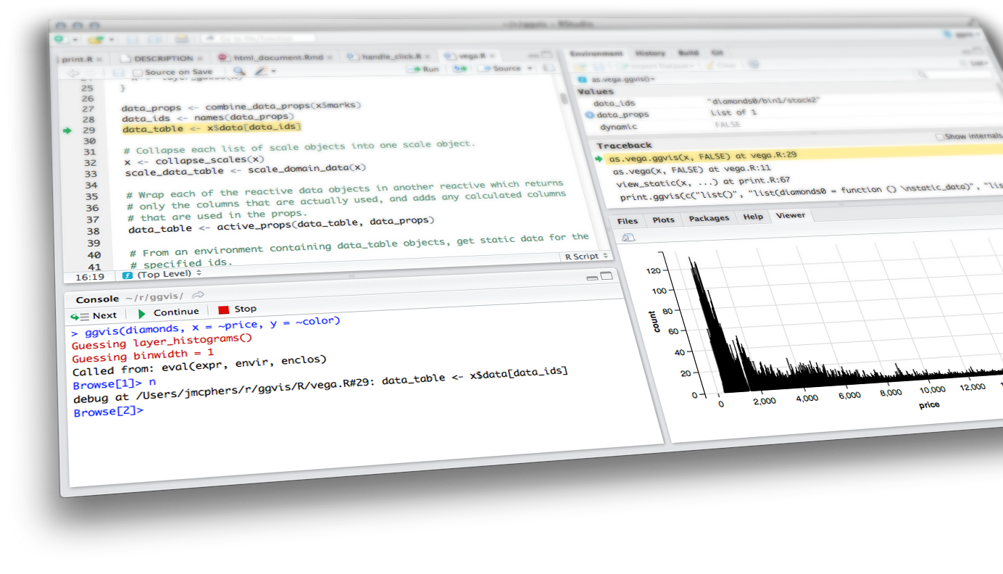
Leaflet

